Slide 1
Trademark Registrations in Bad Faith & How to Revoke Bad Faith Registrations in China
陈一贤 Yixian Chen
钟保禄律师事务所Jones & Co.
Chen.yixian@jonesco-law.ca

Slide 2
Outline
The big word: What is the legal definition of bad faith globally?
Bad Faith Trademark Registrations in China
Legislative evolution and interpretation
Judicial guidance on the circumstantial evidence and the inference of bad faith
Tips for foreign rights owners
Post 2019 amendment – predictions

Slide 3
The concept
Subjectively dishonest;
The opposite of good faith – Culpa in Contrahendo；
Rule of fraus omnia corrumpit (fraud invalidates everything)

Slide 4
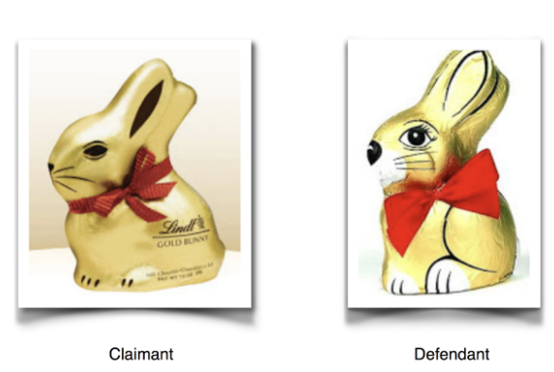
Judicial guidance — Goldhase case in 2009 decided by ECJ
Bad faith depends in particular on three factors:
whether the applicant knows or must know of prior use of an identical or similar sign for identical or similar wares/services;
whether the applicant had the intention to prevent others from using that sign; and
the degree of legal protection of the signs involved.

Slide 5
Legislative evolution in China (1993 - 2019)
 | 1993 Trademark Act | 2001 Trademark Act | 2013 Trademark Act | 2019 Trademark Act
Overarching Principle |  |  | s 7 | ss 4 & 7
Application (opposition) |  | s 31 | s 32 | s 32
 |  |  | s 33 | s 33
Registration (invalidation) | s 27 | s 41(1) | s 44 | s 44
 |  | s 41(2) | s 45 | s 45
Wording used | Fraudulent or illicit means |  | Fraudulent or illicit means + Good faith | Fraudulent or illicit means + Good faith + Bad faith

Slide 6
Interpretation – Post-2019 amendment
Guidelines for the Trial of Trademark Right Granting and Verification Cases (Beijing High People's Court):
Art. 4 of Trademark Act invoked if there is lack of intention to use AND
If the applied mark identical/similar to
Other’s trademarks with certain popularity or distinctiveness;
Other’s non-trademark business signs;
Famous geographic names or names of tourist attractions/ buildings
Filing a large number of applications without a reasonable course
Presumption of lack of intention to use absent evidence to the contrary submitted by the above-mentioned applicant

Slide 7
Judicial guidance on the circumstantial evidence and the inference of bad faith
1. number and class of filings
The number of the filings is sufficiently large:
Max Mara Fashion Group SRL v TRAB, (2015)京知行初字第3634号: more than 500 applications
The nature of the filings:
Volkswagenaktiengesellschaft v TRAB , (2017)京73行初7846号
only 40+ filings in the motor vehicle industry

Slide 8
Judicial guidance on the circumstantial evidence and the inference of bad faith
2. distinctiveness and popularity of infringed mark
Courts are more willing to protect those marks that are relatively distinctive and well-known.
The ‘Crayon Shin-chan’ case (Futabasha Publishers Ltd v TRAB, (2011)高行终字第1428号)

Slide 9
Judicial guidance on the circumstantial evidence and the inference of bad faith
3. applicant’s intent to use
Courts may find a lack of genuine intent to use if the applied mark is not in relation to the applicant’s ordinary business course and needs.
Aobull (Germany) Breweries Ltd v TRAB , (2017)京73行初250号)

Slide 10
Judicial guidance on the circumstantial evidence and the inference of bad faith
4. Other special circumstances
E.g. the relationship between the squatter and the claimant – former director
The ‘Amcham’ series case (American Club v TRAB, (2016)京73行初5710号 and the American Chamber of Commerce in the People’s Republic of China & TRAB v American Club, (2016)京行终2656号)

Slide 11
Tips for foreign rights owners – Helpful provisions in the context of bad faith
Procedural provisions:
Art. 33 – Opposition – three months after publication
Art. 44.1 – Invalidation – five year after registration
Art. 45 – Invalidation – well-known trademark exemption to the five-year rule

Slide 12
Tips for foreign rights owners – Helpful provisions in the context of bad faith
Substantive provisions:
Art. 4: bad-faith filing without intention to use (new since Nov. 2019)
Art. 15: commercial agent or had a contractual relationship
Art. 32: prior rights
Art. 44.1: fraudulent or any other illicit means

Slide 13
Tips for foreign rights owners – Art. 15 commercial agent/contractual relationship
Examples of commercial agent/contractual relationship:
Potential or actual manufacturer/sales agent/distributor/representative;
Business consultant; trademark agent;
Employee; contractor;
Typical evidence:
Manufacturing/sales/distribution contract and corresponding invoices, shipping documents;
Pre-contract negotiation documents: Non-disclosure agreement; Letter of intent, etc.;

Slide 14
Tips for foreign rights owners – Art. 32 prior rights
Examples of prior rights
Copyright
Design patent
Domain name
Trade name; portrait right; name rights; etc.
Well-known trademark status (Art. 13).

Slide 15
Tips for foreign rights owners – Art. 32 prior rights – Cont’d
Critical issues
TIME – material date (date of application)
GEOGRAPHIC LIMITATION – mainland China
CERTAIN INFLUENCE – relevant consumer; length and breadth of use; advertisement/publicity; etc.
OWNERSHIP – to prove that the claimant owns the prior rights
CORE ELEMENT– confusion.

Slide 16
Tips for foreign rights owners – Art. 44.1 fraudulent and illicit means
Article 44.1: a registered trademark may be invalidated on the ground that the registration is obtained through fraudulent or other illicit means.
Prior to the 2019 amendment, Article 41.1 has long been invoked to curb bad faith filings;
Typical approach: defensive + offensive

Slide 17
Case study
Rights holder: Canadian nutraceutical company
Squatter: A domestic Chinese company
Rights holder sells in China without trademark registration for its Chinese character trademarks;
Squatter registered the Chinese character trademarks;
Squatter sued the rights holder’s Chinese distributor and asked for an exorbitant amount of money to settle and transfer the marks.
Invoked Art. 7; 13; 32; 44.1
Evidence includes results factual background of the squatter; squatter’s portfolio in China; Canadian company’s sales and reputation in China; infringement lawsuit; communication records regarding the ask for settlement

Slide 18
Tips for foreign rights owners – General practice
FILE EARLY!
Before the officially enter China
KNOW YOUR BUSINESS PARTNER
Who are you dealing with in China – Chinese character name;
Keep records
OBJECT EARLY
Monitor new pirate applications and intervene early;
Clear and strong evidence;
Case-by-case study and analyze factual evidence available

Slide 19
Post 2019 amendment – predictions
Bad faith has become a more frequently and successfully used ground to for cracking down on bad-faith filings in China;
A more consistent treatment of trademark piracy and squatting cases.

Slide 20
Trademark Registrations in Bad Faith & How to Revoke Bad Faith Registrations in China
陈一贤 Yixian Chen
钟保禄律师事务所Jones & Co.
Chen.yixian@jonesco-law.ca

